Slide 1
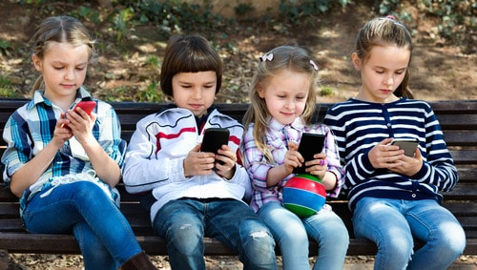
How much technology can help our kinds and how much it can damage their lives?
TED Talk Prof. Dr. Ana X. Halabi
Universidad de La Sabana – 8NOV19 – ana.halabi@unisabana.edu.co

Slide 2
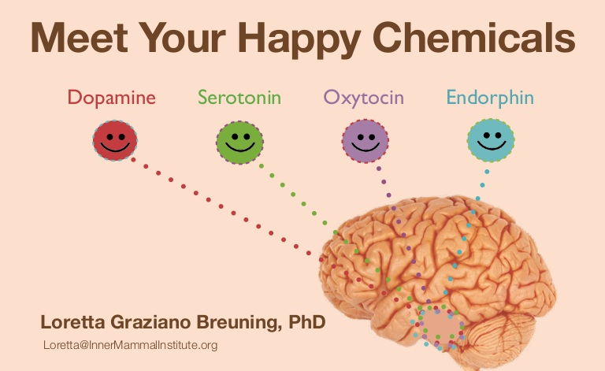
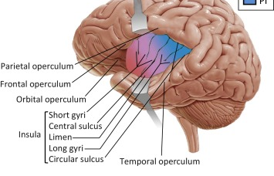
Did you know that over exposure to screens kill around 80% of our kid’s neurons, more specifically in an area of the brain called insula, which has to do with compassion and empathy?
TED Talk Prof. Dr. Ana X. Halabi
Universidad de La Sabana – 8NOV19 – ana.halabi@unisabana.edu.co

Slide 3
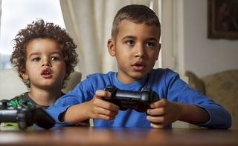
Did you know that 1 videogame played by our kids is equivalent to a shot the heroine? the brain cannot bear so much pleasure.
World Psychiatric Association (WPA)
TED Talk Prof. Dr. Ana X. Halabi
Universidad de La Sabana – 8NOV19 – ana.halabi@unisabana.edu.co

Slide 4
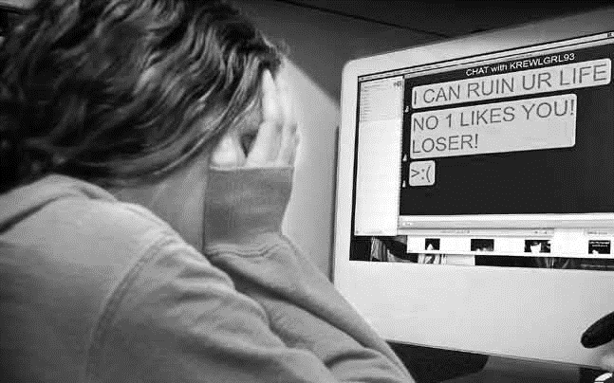
Risks our kids face many times far from our control
Cyberbulling
TED Talk Prof. Dr. Ana X. Halabi
Universidad de La Sabana – 8NOV19 – ana.halabi@unisabana.edu.co
Notes:
Cyberbullying or cyberharassment is a form of bullying or harassment using electronic means. Cyberbullying and cyberharassment are also known as online bullying. It has become increasingly common, especially among teenagers

Slide 5
Risks our kids face many times far from our control
Child Grooming
TED Talk Prof. Dr. Ana X. Halabi
Universidad de La Sabana – 8NOV19 – ana.halabi@unisabana.edu.co
Notes:
Child grooming is befriending and establishing an emotional connection with a child, and sometimes the family, to lower the child's inhibitions with the objective of sexual abuse.

Slide 6
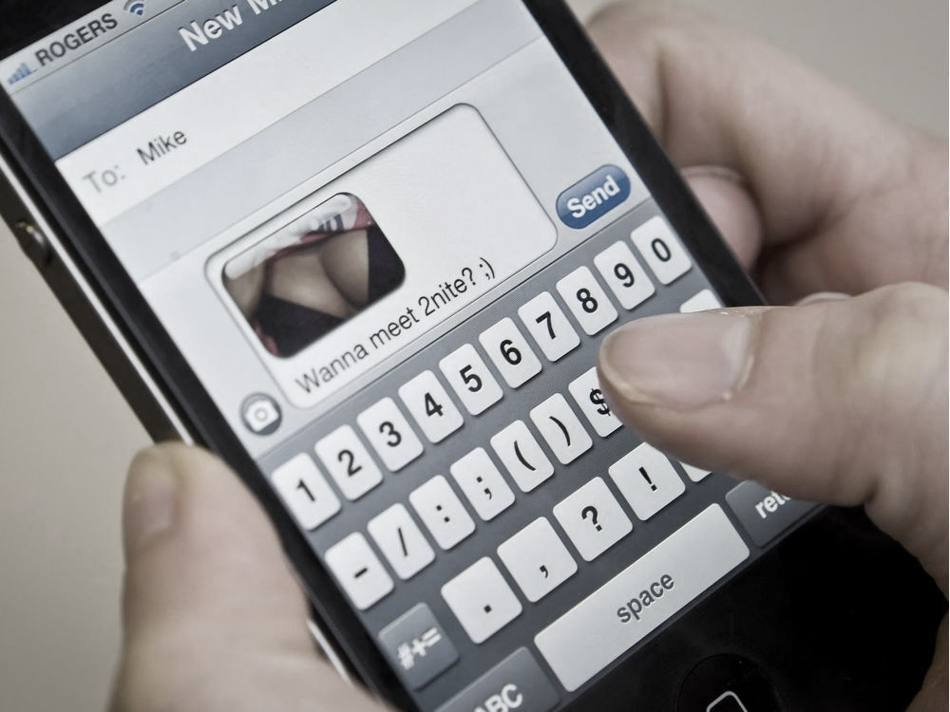
Risks our kids face many times far from our control
Sexting
TED Talk Prof. Dr. Ana X. Halabi
Universidad de La Sabana – 8NOV19 – ana.halabi@unisabana.edu.co
Notes:
Sexting is sending, receiving, or forwarding sexually explicit messages, photographs, or images, primarily between mobile phones, of oneself to others. It may also include the use of a computer or any digital device

Slide 7
When a kid plays fortnite, his/her blood pressure goes up to 200 to 210
TED Talk Prof. Dr. Ana X. Halabi
Universidad de La Sabana – 8NOV19 – ana.halabi@unisabana.edu.co

Slide 8
Kids are wearing diapers, so as not to stand and go to the bathroom but keep playing. Some of them last 8 hours. You have to understand that this is addiction.
TED Talk Prof. Dr. Ana X. Halabi
Universidad de La Sabana – 8NOV19 – ana.halabi@unisabana.edu.co
Notes:
Lag terms =periodos del pasado considerados

Slide 9
TED Talk Prof. Dr. Ana X. Halabi
Universidad de La Sabana – 8NOV19 – ana.halabi@unisabana.edu.co

Slide 10
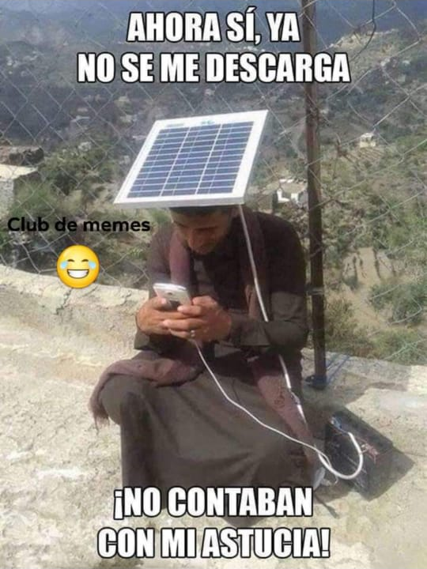
…because they constantly watch us ... and see us use them.
TED Talk Prof. Dr. Ana X. Halabi
Universidad de La Sabana – 8NOV19 – ana.halabi@unisabana.edu.co

Slide 11
How much technology can help our kinds and how much it can damage their lives?
TED Talk Prof. Dr. Ana X. Halabi
Universidad de La Sabana – 8NOV19 – ana.halabi@unisabana.edu.co

