Slide 1
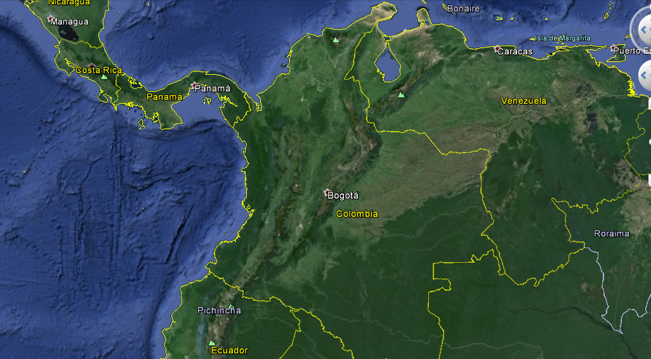
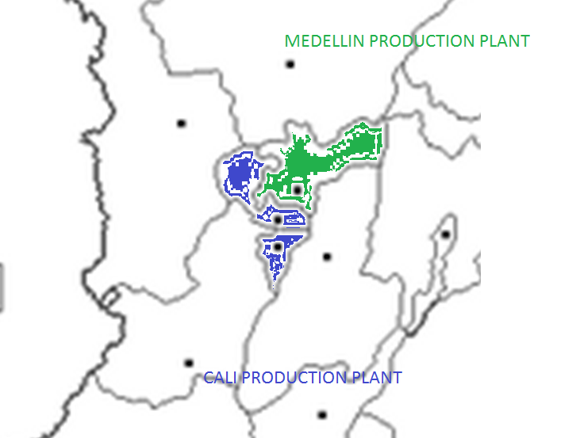
Improve the delivery performance of newspapers
Student: Ronald Rojas Sánchez, GCLOG 2014
Advisor: Roberto Perez-Franco
Motivation / Background
Localization
Graphic Results
In Colombia, the main Newspaper is El Tiempo, and have 4 production plants in the principal markets. The next market (the 5th) is the Cafetal Zone and there is no Production Plant.
In the Colombian Cafetal Zone, the newspapers to delivery El Tiempo Casa Editorial, arrive very late to his subscriptors.
It is thought that if the arrival time of the newspaper to this area is improved, the level of sales in the region to improve, and clearly will improve service to current customers.
MEDELLIN Production Plant
Panama
Venezuela
Colombia
Manizales
Pereira
Key Question / Hypothesis
Armenia
What can be done to improve the time of the arrival of the newspaper to the readers?
Ecuador
Brasil
Methodology
Relevant Literature
CALI Production Plant
1. There will be designed a list of the information that it will have to obtain.
2. An Excel model will be designed, that there allows to work the information that is obtained.
3. The principals scenarios are concluded in a 11 options of the model.
4. The Solver Tool of Excel chose the better option, analyzing the variables of Time, Cost and Reliability.
5. The results of the project will appear.
- Supply Chain Management, Strategy, Planning, and Operation. By Sunil Chopra and Peter Meindl
Expected Contribution
The Problem
Improvement of the travel time to Manizales in a 22%. The time to arrive to Manizales will be from 300 minutes to 235 minutes.
It means that the newspaper goes from 5,15 am to 4.10 am, with a spare of one hour, five 5 minutes.
  The clients and subscripts will notice the difference. It is expected that the quantities of newspaper sold are higher.
Based in the compilation of information available from hours, routes, times, distances, reliability of the roads and with the support of mathematical models that will work qualitative and quantitative information it will have to determine one optimal solution.
The best alternative should be validated, so with reasonable costs, and using alternative logistics only (without building any plant), improve the time of arrival of the newspapers, in the coffee zone.
Results
The best option is to divide the coffee zone in 2 areas, each one located near the production plant nearby
- The printing of the newspapers to Armenia and Pereira should be in Cali, and must be delivered in a single truck.
- The printing of the newspapers to Manizales should be in Medellín.
Ronald Rojas Sánchez

